Slide 1

ENHANCING OPERATIONAL EFFICIENCY AND PROFITABILITY THROUGH RELIABLE SUPPLY SOLUTIONS FOR GOVERNMENT AND PRIVATE ENTITIES
Presented by:
DEVANSH GUPTA
22F3002843

Slide 2

Contents
01. About The Business
02. Challenges faced
A brief introduction of the organization.
An overview of the problems faced by the business.
03. Data Collection
04. Analysis Process
05. Key Findings
06. Recommendations
An overview of nature of data collected and cleaning process.
Approach for Data Analysis.
Critical Insights and Results.
.
Recommendations to the organization after analysis.
July, 2025

Slide 3
About the Business
Rakhi Innovative Venture is a Kanpur-based B2B trading firm, that has been operating for over 5 years, engaged in the supply of printing materials, office stationery, and general-purpose goods. The firm primarily serves government institutions and public-sector departments, which contribute to nearly 65–70% of its business. The remaining share comes from private clients including small businesses, and educational institutions.
Operating from two offices for improved efficiency, the business has built its reputation on trust, timely fulfillment, and competitive pricing. With a small team led by the owner and supported by two staff members, Rakhi Innovative Venture handles procurement, inventory, and client servicing through relationship-driven strategies.
July, 2025

Slide 4
Challenges faced
Supply Chain Inefficiencies: Overstocking and stockouts due to poor inventory tracking, along with dependence on limited suppliers, leads to delayed procurement and missed order opportunities.
Market Competition: The firm faces intense competition from lower-priced vendors. Lack of digital presence and limited product diversification reduces its ability to attract and retain clients.
Cash Flow Challenges: Delayed payments especially from government clients combined with irregular sales cycles create liquidity issues, making it difficult to manage day-to-day operations smoothly.
July, 2025

Slide 5
Data Collection
Data was collected from Rakhi Innovative Venture through few visits between January and April 2025, covering the period from April 2022 to March 2025. Sources included Tally software exports, manual digital registers, and informal interviews with the operational manager. The dataset includes sales, purchases, inventory, product categories, and client types.
Data Preprocessing: The data was cleaned by removing duplicates, correcting formats, and standardizing units (e.g., pcs, kg). Products were categorized into six segments: Printing, Stationery, Electronics, Household, Decor, and Construction. Cleaned data was organized into Excel sheets. To summarize and interpret the data, descriptive statistics were applied using Excel formulas. Key measures included mean (average quantity sold per order), mode (most frequently sold quantity), standard deviation (variation in order sizes), average sales and purchase values, profit margins, and maximum quantity sold in a single order.
July, 2025

Slide 6
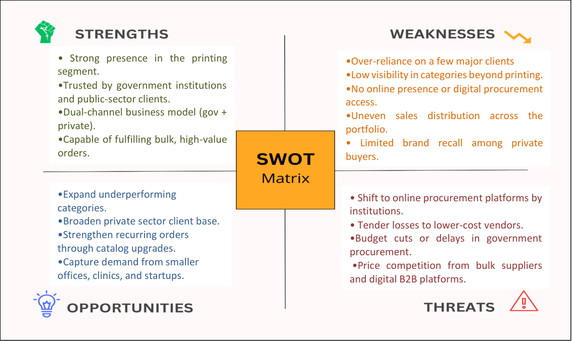
Analysis Process
The analysis process combined both quantitative and qualitative approaches to understand the business operations.
Using cleaned datasets, I applied tools such as pivot tables, line graphs, bar charts, and conditional formatting to visualize trends in sales, purchases, stock movement, and revenue.
The analysis included ETS forecasting for future sales, SWOT analysis for strategic insights, and identification of seasonal trends to understand demand patterns and optimize procurement and planning.
July, 2025

Slide 7
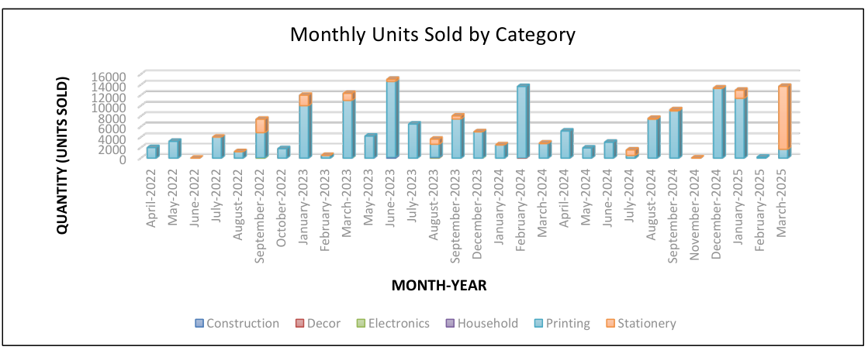
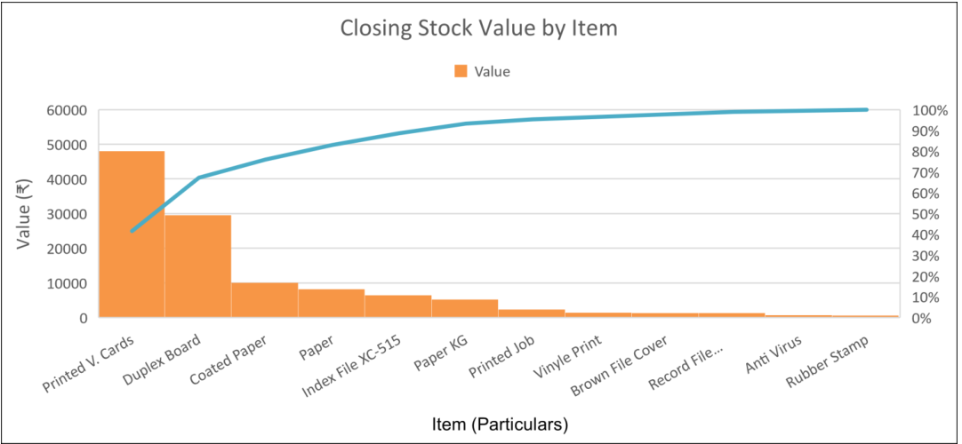
Key Findings – Supply Chain Management
Printing category dominates monthly sales, showing consistent high demand throughout the period.
Stationery sales are seasonal, with sharp spikes in specific months, likely linked to academic or fiscal cycles.
Low movement in categories like Electronics, Decor, and Household indicates underutilized stock or low market demand.
Closing stock value is concentrated in a few items like Printed Visiting Cards and Duplex Board account for the majority..
July, 2025

Slide 8
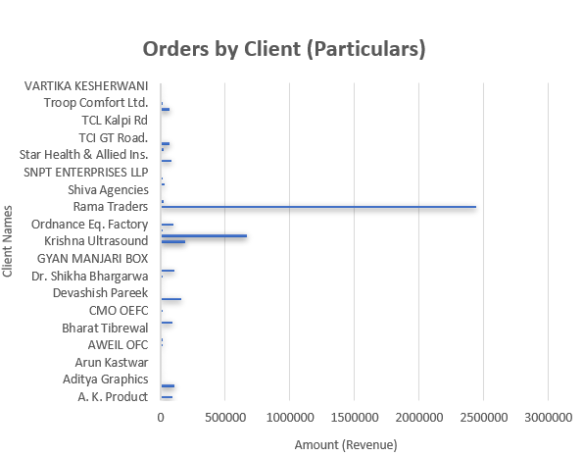
Key Findings – Market Competition
Rama Traders alone contributes the highest revenue. However, this over-reliance poses a risk if the client shifts vendors or reduces orders.
Top 3 clients (Rama Traders, Krishna Ultrasound, Ordnance Eq. Factory) account for the majority of business volume.
Most other clients contribute minimally, showing limited client base penetration.
Revenue distribution is highly skewed, making the business vulnerable if any key client stops ordering.
Lack of diversification in clientele highlights the need for stronger marketing and outreach to attract new customers.
Due to established relationships, consistent high-volume orders, or possibly exclusive pricing/service terms, Rama Traders has become a preferred buyer.
July, 2025

Slide 9
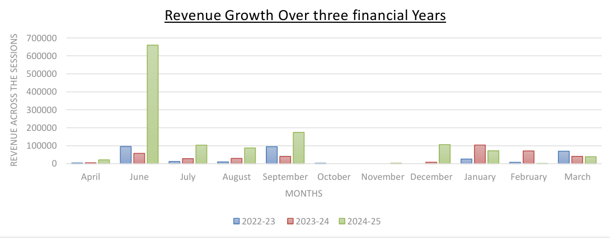
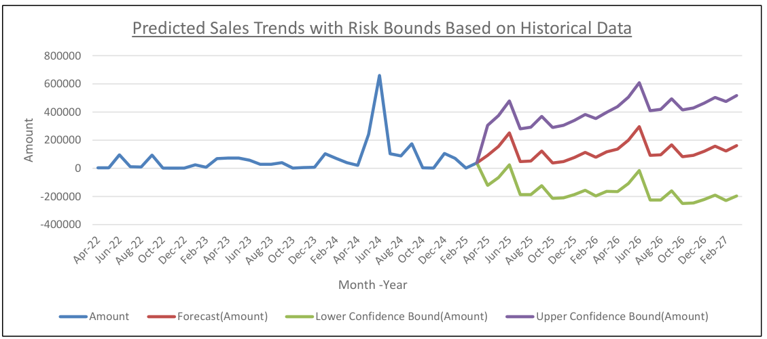
Key Findings – Cash Flow Challenges
Revenue is highly volatile, with sharp peaks in months like June and September, followed by sudden drops. June 2024 saw an exceptional spike, indicating dependence on bulk or seasonal government orders.
Inconsistent monthly revenue creates planning challenges and strains liquidity in low-income periods.
Forecasting (ETS model) shows a potential for steady growth but with moderate-to-high volatility.
Confidence bounds reveal risk, suggesting that without better planning, future cash flow could fluctuate significantly.
July, 2025

Slide 10
Recommendations
Operational Efficiency : Plan inventory using monthly demand trends and maintain optimal stock for fast-moving items. Use reorder points or basic inventory software and also negotiate better vendor terms to align with payment cycles.
Sales & Market Expansion: Promote low-selling items via combos or bundles. Expand product catalog with niche/customized options. Strengthen digital presence through WhatsApp, Google, or a basic website. Re-engage inactive clients with calls and simple catalogs.
Financial & Cash Flow Management: To strengthen financial stability, track monthly cash flow closely and allocate reserve funds regularly. Encourage faster payments by offering early payment discounts to private clients. Actively leverage the GeM portal to secure more government tenders. Simultaneously, expand the client base by targeting new private entities such as clinics, schools, and startups, ensuring a balanced and diversified revenue stream..
Thank you
July, 2025
Thank you for your time and thank you for all the support throughout the project.

